Slide 1
Market Basket Analysis and
Mining Association Rules
1

Slide 2
Mining Association Rules
Market Basket Analysis
What is Association rule mining
Apriori Algorithm
2

Slide 3
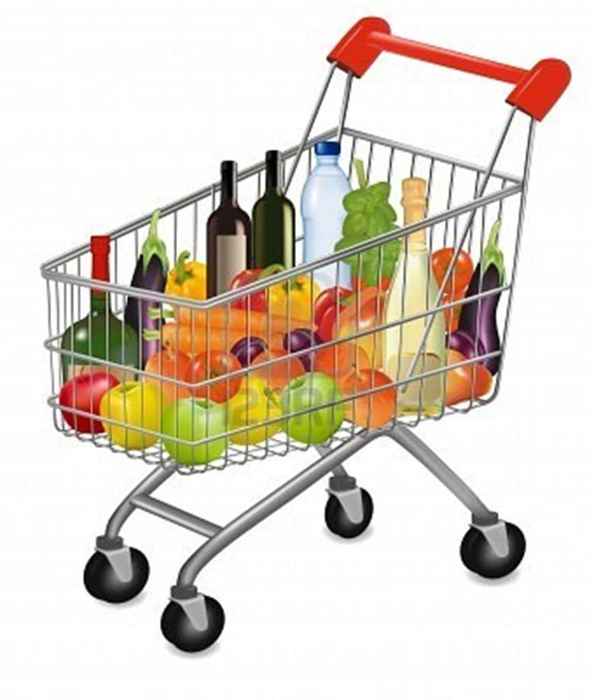
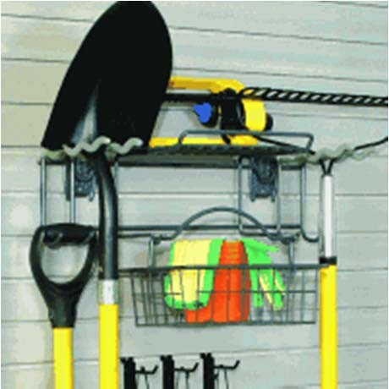
Market Basket Analysis
One basket tells you about what one customer purchased at one time.
A loyalty card makes it possible to tie together purchases by a single customer (or household) over time.
3

Slide 4
Market Basket Analysis
Retail – each customer purchases different set of products, different quantities, different times
MBA uses this information to:
Identify who are these customers (not by name)
Understand why they make certain purchases
Gain insight about its merchandise (products):
Fast and slow movers
Products which are purchased together
Products which might benefit from promotion
Take action:
Store layouts
Which products to put on specials, promote, coupons…
Combining all of this with a customer loyalty card it becomes even more valuable

Slide 5
More than just the contents of shopping carts
It is also about what customers do not purchase, and why.
If customers purchase baking powder, but no flour, what are they baking?
If customers purchase a mobile phone, but no case, are you missing an opportunity?
It is also about key drivers of purchases; for example, the gourmet mustard that seems to lie on a shelf collecting dust until a customer buys that particular brand of special gourmet mustard in a shopping excursion that includes hundreds of dollars' worth of other products. Would eliminating the mustard (to replace it with a better‐selling item) threaten the entire customer relationship?

Slide 6
Market Basket Analysis
association rules can be applied on other types of “baskets.”
Items purchased on a credit card, such as rental cars and hotel rooms, provide insight into the next product that customers are likely to purchase,
Optional services purchased by telecommunications customers (call waiting, call forwarding, DSL, speed call, and so on) help determine how to bundle these services together to maximize revenue.
Banking products used by retail customers (money market accounts, certificate of deposit, investment services, car loans, and so on) identify customers likely to want other products.
Unusual combinations of insurance claims can be a sign of fraud and can spark further investigation.
Medical patient histories can give indications of likely complications based on certain combinations of treatments.

Slide 7
Market Basket Analysis
The order is the fundamental data structure for market basket data. An order represents a single purchase event by a customer.
The customer entity is optional and should be available when a customer can be identified over time.
Tracking customers over time makes it possible to determine, for instance, which grocery shoppers “bake from scratch”
interesting to the makers of flour as well as prepackaged cake mixes and the makers of aprons and kitchen appliances.
The store entity provides information about where the products are purchased.

Slide 8
Mining Association Rules
Market Basket Analysis
What is Association rule mining
Apriori Algorithm

Slide 9
What Is Association Rule Mining?
Association rule mining
Finding frequent patterns, associations, correlations, or causal structures among sets of items in transaction databases
Understand customer buying habits by finding associations and correlations between the different items that customers place in their “shopping basket”
Applications
Basket data analysis, cross‐marketing, catalog design, loss‐leader analysis, web log analysis, fraud detection (supervisor‐>examiner)

Slide 10
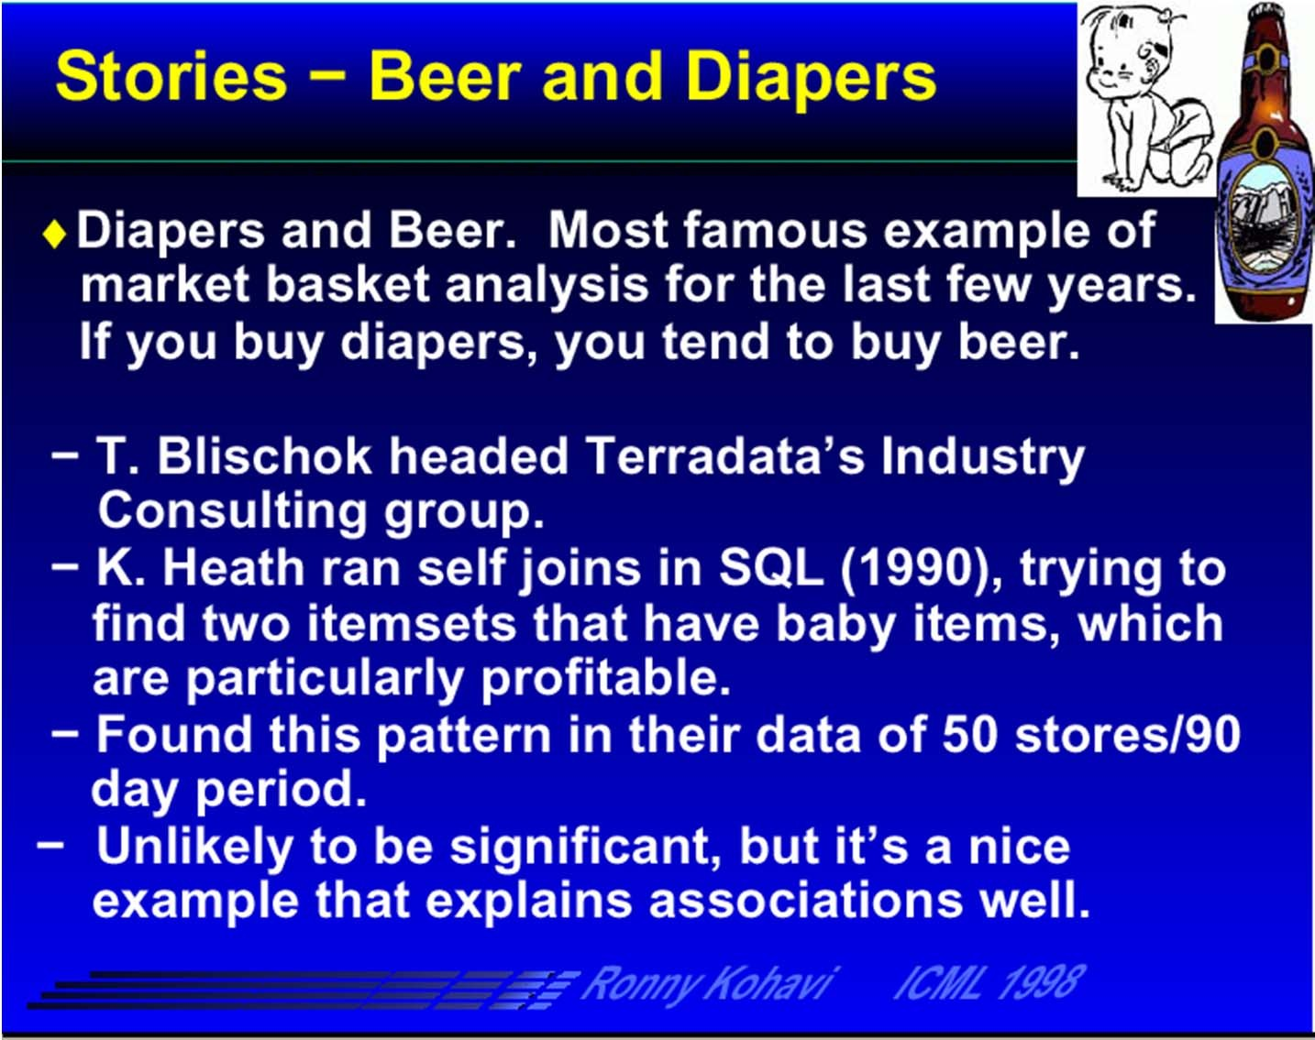
How can Association Rules be used?
Probably mom was calling dad at work to buy diapers on way home and he decided to buy a six‐ pack as well.
The retailer could move diapers and beers to separate places and position high‐profit items of interest to young fathers along the path.

Slide 11
What Is Association Rule Mining?
Rule form
Antecedent → Consequent [support, confidence]
(support and confidence are user defined measures of interestingness)
Examples
buys(x, “computer”) → buys(x, “financial management software”) [0.5%, 60%]
age(x, “30..39”) ^ income(x, “42..48K”) → buys(x, “car”) [1%,75%]

Slide 12
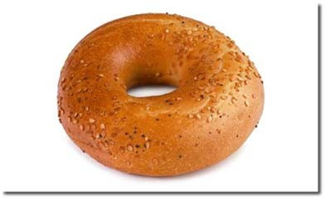
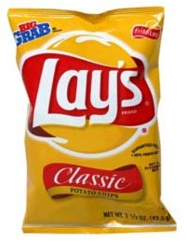
How can Association Rules be used?
Let the rule discovered be
{Bagels,...} → {Potato Chips}
Potato chips as consequent => Can be used to determine what should be done to boost its sales
Bagels in the antecedent => Can be used to see which products would be affected if the store discontinues selling bagels
Bagels in antecedent and Potato chips in the consequent => Can be used to see what products should be sold with Bagels to promote sale of Potato Chips

Slide 13
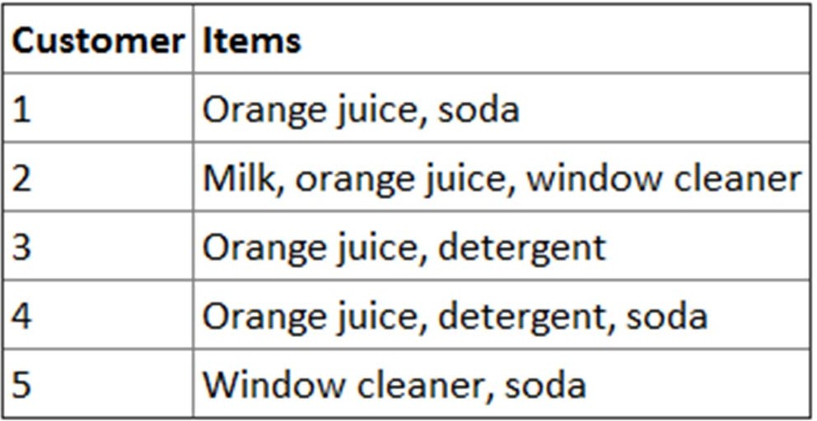
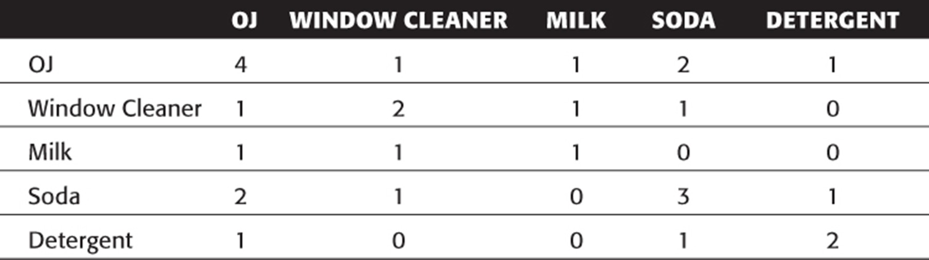
Orange juice and soda are more likely to be purchased together than any other two items.
Detergent is never purchased with window cleaner or milk. Milk is never purchased with soda or detergent.

Slide 14
Association rule types
Actionable Rules
contain high‐quality, actionable information
Trivial Rules
information already well‐known by those familiar with the business
Inexplicable Rules
no explanation and do not suggest action
Trivial and Inexplicable Rules occur most often

Slide 15
Rules
Wal‐Mart customers who purchase Barbie dolls have a 60% likelihood of also purchasing one of three types of candy bars [Forbes, Sept 8, 1997]
Customers who purchase maintenance agreements are very likely to purchase large appliances (Linoff and Berry experience)
When a new hardware store opens, one of the most commonly sold items is toilet bowl cleaners (Linoff and Berry experience)

Slide 16
Basic Concepts
Given:
(1) database of transactions,
(2) each transaction is a list of items purchased by a customer in a visit
Find:
all rules that correlate the presence of one set of items (itemset) with that of another set of items
E.g., 35% of people who buys salmon also buys cheese

Slide 17
Rule Basic Measures
A ⇒ B [ s, c ]
Support: denotes the frequency of the rule within transactions. A high value means that the rule involves a great part of database.
support(A ⇒ B [ s, c ]) = p(A ∪ B)
Confidence: denotes the percentage of transactions containing A which also contain B. It is an estimation of conditioned probability .
confidence(A ⇒ B [ s, c ]) = p(B|A) = sup(A,B)/sup(A).

Slide 18
Tr1 | Shoes, Socks, Tie, Belt
Tr2 | Shoes, Socks, Tie, Belt, Shirt, Hat
Tr3 | Shoes, Tie
Tr4 | Shoes, Socks, Belt
Transaction | Shoes | Socks | Tie | Belt | Shirt | Scarf | Hat
1 | 1 | 1 | 1 |  | 0 | 0 | 0
2 | 1 | 1 | 1 | 1 | 1 | 0 | 1
3 | 1 | 0 | 1 | 0 | 0 | 0 | 0
4 | 1 | 1 | 0 | 1 | 0 | 0 | 0
...
Support is
50% (2/4)
Socks ⇒ Tie
Confidence is
66.67% (2/3)

Slide 19
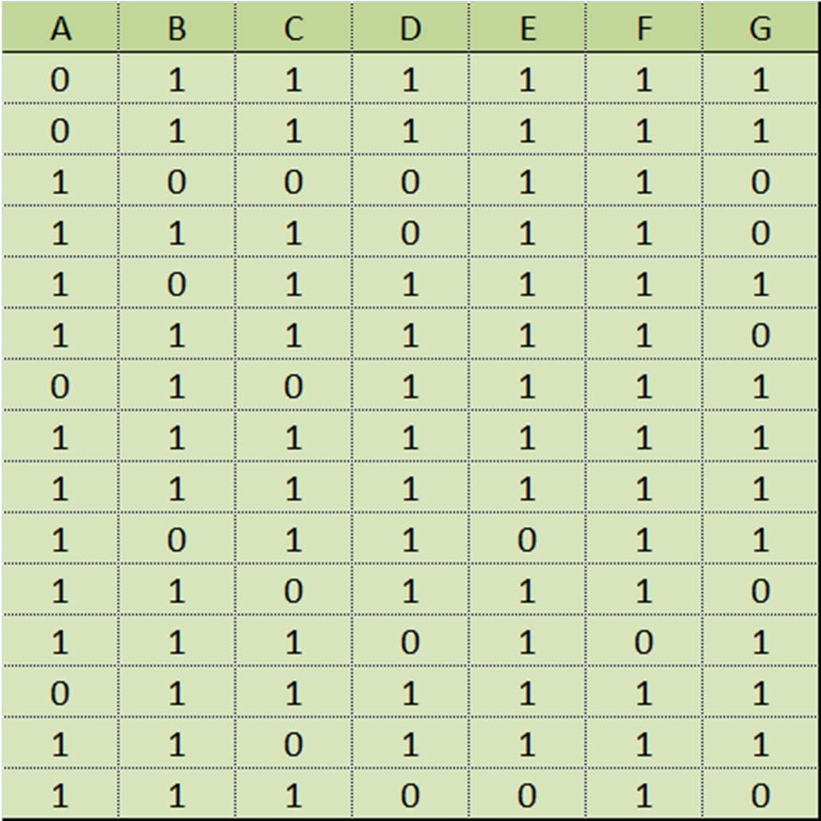






















transactions
Rule C => D
support
confidence
/

Slide 20
Other Applications
“Baskets” = documents
“items” = words in those documents
Lets us find words that appear together unusually frequently, i.e., linked concepts.
 | Word 1 | Word 2 | Word 3 | Word 4
Doc 1 | 1 | 0 | 1 | 1
Doc 2 | 0 | 0 | 1 | 1
Doc 3 | 1 | 1 | 1 | 0
Word 4 => Word 3
When word 4 occurs in a document there a big probability of word 3 occurring

Slide 21
Other Applications
“Baskets” = sentences
“items” = documents containing those sentences
Items that appear together too often could represent plagiarism.
 | Doc 1 | Doc 2 | Doc 3 | Doc 4
Sent 1 | 1 | 0 | 1 | 1
Sent 2 | 0 | 0 | 1 | 1
Sent 3 | 1 | 1 | 1 | 0
Doc 4 => Doc 3
When a sentence occurs in document 4 there is a big probability of occurring in document 3

Slide 22
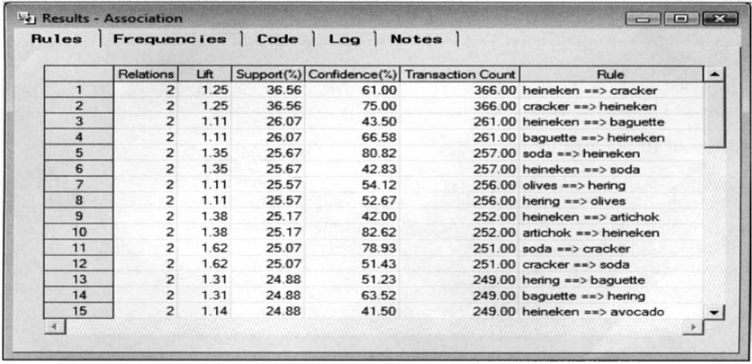
Randall Matignon 2007, Data Mining Using SAS Enterprise Miner, Wiley (book).

Slide 23
Mining Association Rules
Market Basket Analysis
What is Association rule mining
Apriori Algorithm

Slide 24
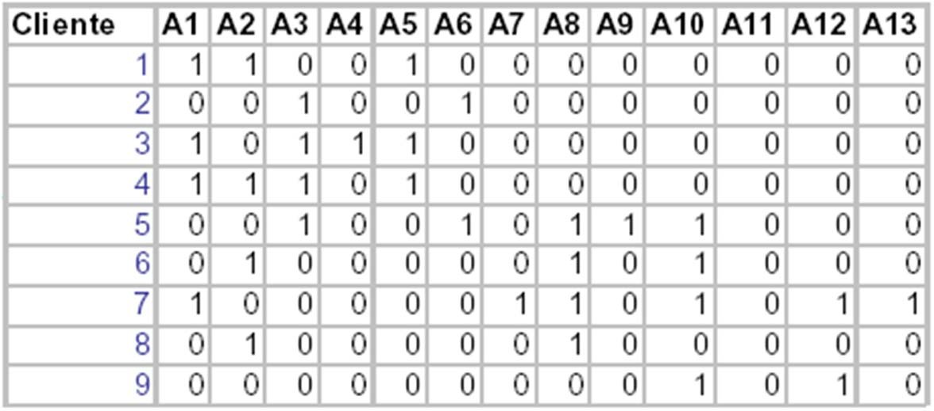
Boolean association rules
Each transaction is converted to a Boolean vector

Slide 25
Finding Association Rules
Approach:
Find all itemsets that have high support
‐ These are known as frequent itemsets
Generate association rules from frequent itemsets

Slide 26
Itemset Lattice for 5 products
null
A
B
C
D
E
AB
AC
AD
AE
BC
BD
BE
CD
CE
DE
ABC
ABD
ABE
ACD
ACE
ADE
BCD
BCE
BDE
CDE
ABCD
ABCE
ABDE
ACDE
BCDE
ABCDE

Slide 27
Apriori principle
Any subset of a frequent itemset must be
frequent
A transaction containing {beer, diaper, nuts} also contains
{beer, diaper}
{beer, diaper, nuts} is frequent → {beer, diaper} must also be frequent

Slide 28
Apriori principle
No superset of any infrequent itemset should be generated or tested
Many item combinations can be pruned

Slide 29
Apriori principle for pruning candidates
If an itemset is infrequent, then all of its supersets must also be infrequent
null
A
B
C
D
E
AB
AC
AD
AE
BC
BD
BE
CD
CE
DE
Found to be Infrequent
ABC
ABD
ABE
ACD
ACE
ADE
BCD
BCE
BDE
CDE
Pruned supersets
ABCD
ABCE
ABDE
ACDE
BCDE
ABCDE

Slide 30
Mining Frequent Itemsets (the Key Step)
Find the frequent itemsets: the sets of items that have (at least) minimum support
A subset of a frequent itemset must also be a frequent itemset
Generate length (k+1) candidate itemsets from length k frequent itemsets, and
Test the candidates against DB to determine which are in fact frequent

Slide 31
How to Generate Candidates? ‐ step 1
The items in L_{k‐1} are listed in an order
Step 1: self‐joining L_{k‐1}
insert into C_{k}
select p.item₁, p.item₂, …, p.item_{k‐1}, q.item_{k‐1}
from L_{k‐1} p, L_{k‐1} q
where p.item₁=q.item₁, …, p.item_{k‐2}=q.item_{k‐2}, p.item_{k‐1} < q.item_{k‐1}
A
D
E
=
=
<
A
D
F

Slide 32


L3 – set of itemsets of size 3 that are frequent
(itemsets need to be sorted)
itemset 1 | A | B | C
itemset 2 | A | D | E
itemset 3 | A | D | F
itemset 4 | A | E | F
A,D,E,F
Two itemsets with the same k ‐ 1 = 3 ‐ 1 elements are merged and inserted in C4 (the set of candidate itemsets of size 4).
Those in C4 that have support above the threshold are inserted in L4.

Slide 33

The Apriori Algorithm — Example
Min. support: 2 transactions
Database D
C
itemset | sup.
{1} {2} {3} | 2 3 3
{4} | 1
{5} | 3
TID | Items
100 | 1 3 4
200 | 2 3 5
300 | 1 2 3 5
400 | 2 5
1
L
itemset | sup.
{1} | 2
{2} | 3
{3} | 3
{5} | 3
1
Scan D
C₂
itemset | sup
{1 2} | 1
{1 3} | 2
{1 5} | 1
{2 3} {2 5} {3 5} | 2 3 2
C₂
itemset
L₂
itemset | sup
{1 3} | 2
{2 3} | 2
{2 5} | 3
{3 5} | 2
{1 2}
{1 3}
{1 5}
{2 3}
{2 5}
{3 5}
Scan D
C₃
itemset
Scan D
L₃
itemset | sup
{2 3 5} | 2
{2 3 5}
https://en.wikipedia.org/wiki/Apriori_algorithm

Slide 34
How to Generate Candidates? – step 2
Step 2: pruning
for all itemsets c in C_{k} do
for all (k‐1)‐subsets s of c do
if (s is not in L_{k‐1}) then delete c from C_{k}
A | D | E | F
Note: In step 1 we may generate candidates that include itemsets of size k‐1 that are not frequent.
The pruning step may be able to eliminate some candidates without counting their support.
Counting support is a computationally demanding task.
41

Slide 35
Example of Generating Candidates – step 1
L₃ = {abc, abd, acd, ace, bcd}
Self‐joining: L₃*L₃
joining abc and abd gives abcd
joining acd and ace gives acde

Slide 36
Example of Generating Candidates – step 2
L₃ = {abc, abd, acd, ace, bcd}
Pruning (before counting its support):
abcd: check if abc, abd, acd, bcd, are in L3
acde: check if acd, ace, ade, cde are in L3
acde is removed because ade is not in L₃
Thus C₄={abcd}

Slide 37
The Apriori Algorithm
C_{k}: Candidate itemset of size k L_{k} : frequent itemset of size k
Join Step: C_{k} is generated by joining L_{k‐1} with itself
Prune Step: Any (k‐1)‐itemset that is not frequent cannot be a subset of a frequent k‐itemset
Algorithm:
L₁ = {frequent items};
for (k = 1; L_{k} !=∅; k++) do begin
C_{k+1} = candidates generated from L_{k};
for each transaction t in database do
increment the count of all candidates in C_{k+1} that are contained in t
L_{k+1} = candidates in C_{k+1} with min_support
end
return L = ∪_{k} L_{k};

Slide 38
Generating AR from frequent intemsets
Confidence (A⇒B) = P(B|A) =
support_count({A,B})
support_count({A})
For every frequent itemset x, generate all non‐empty subsets of x
For every non‐empty subset s of x, output the rule “ s ⇒ (x‐s) ” if
support_count({x}) _{≥ min_conf}
support_count({s})

Slide 39
Rule Generation
How to efficiently generate rules from frequent itemsets?
In general, confidence does not have an anti‐monotone property
But confidence of rules generated from the same itemset has an anti‐monotone property
L = {A,B,C,D}:
c(ABC → D) ≥ c(AB → CD) ≥ c(A → BCD)
Confidence is non‐increasing as number of items in rule consequent increases

Slide 40
Exercice
TID | Items
1 | Bread, Milk, Chips, Mustard
2 | Beer, Diaper, Bread, Eggs
3 | Beer, Coke, Diaper, Milk
4 | Beer, Bread, Diaper, Milk, Chips
5 | Coke, Bread, Diaper, Milk
6 | Beer, Bread, Diaper, Milk, Mustard
7 | Coke, Bread, Diaper, Milk
Converta os dados para o formato booleano e para um suporte de 40%, aplique o algoritmo apriori.
Bread | Milk | Chips | Mustard | Beer | Diaper | Eggs | Coke
1 | 1 | 1 | 1 | 0 | 0 | 0 | 0
1 | 0 | 0 | 0 | 1 | 1 | 1 | 0
0 | 1 | 0 | 0 | 1 | 1 | 0 | 1
1 | 1 | 1 | 0 | 1 | 1 | 0 | 0
1 | 1 | 0 | 0 | 0 | 1 | 0 | 1
1 | 1 | 0 | 1 | 1 | 1 | 0 | 0
1 | 1 | 0 | 0 | 0 | 1 | 0 | 1

Slide 41






0.4*7= 2.8
C1
Bread | 6
Milk | 6
Chips | 2
Mustard | 2
Beer | 4
Diaper | 6
Eggs | 1
Coke | 3
L1
Bread 6
Milk 6
Beer 4
Diaper 6
Coke 3
C2
Bread,Milk | 5
Bread,Beer | 3
Bread,Diaper | 5
Bread,Coke | 2
Milk,Beer | 3
Milk,Diaper | 5
Milk,Coke | 3
Beer,Diaper | 4
Beer,Coke | 1
Diaper,Coke | 3
L2
Bread,Milk 5
Bread,Beer 3
Bread,Diaper 5
Milk,Beer 3
Milk,Diaper 5
Milk,Coke 3
Beer,Diaper 4
Diaper,Coke 3
C3
Bread,Milk,Beer | 2
Bread,Milk,Diaper 4 Bread,Beer,Diaper 3 Milk,Beer,Diaper 3
Milk,Beer,Coke
Milk,Diaper,Coke 3
L3
Bread,Milk,Diaper | 4
Bread,Beer,Diaper | 3
Milk,Beer,Diaper | 3
Milk,Diaper,Coke | 3
8 + C ⁸ + C ⁸ = 92
2 3
>> 24

Slide 42
Some Suggestions
By increasing the price of Barbie doll and giving the type of candy bar free, wal‐mart can reinforce the buying habits of that particular types of buyer
Highest margin candy to be placed near dolls.
Special promotions for Barbie dolls with candy at a slightly higher margin.
Take a poorly selling product X and incorporate an offer on this which is based on buying Barbie and Candy. If the customer is likely to buy these two products anyway then why not try to increase sales on X?
Probably they can not only bundle candy of type A with Barbie dolls, but can also introduce new candy of Type N in this bundle while offering discount on whole bundle. As bundle is going to sell because of Barbie dolls & candy of type A, candy of type N can get free ride to customers houses. And with the fact that you like something, if you see it often, Candy of type N can become popular.

Slide 43
References
Jiawei Han and Micheline Kamber, “Data Mining: Concepts and Techniques”, 2 edition (4 Jun 2006),
Gordon S. Linoff and Michael J. Berry, “Data Mining Techniques: For Marketing, Sales, and Customer Relationship Management”, 3rd Edition edition (1 April 2011)
Vipin Kumar and Mahesh Joshi, “Tutorial on High Performance Data Mining ”, 1999
Rakesh Agrawal, Ramakrishnan Srikan, “Fast Algorithms for Mining Association Rules”, Proc VLDB, 1994
(http://www.cs.tau.ac.il/~fiat/dmsem03/Fast%20Algorithms%20for%20Mining%20Association%20Rules.ppt)

